Slide 1
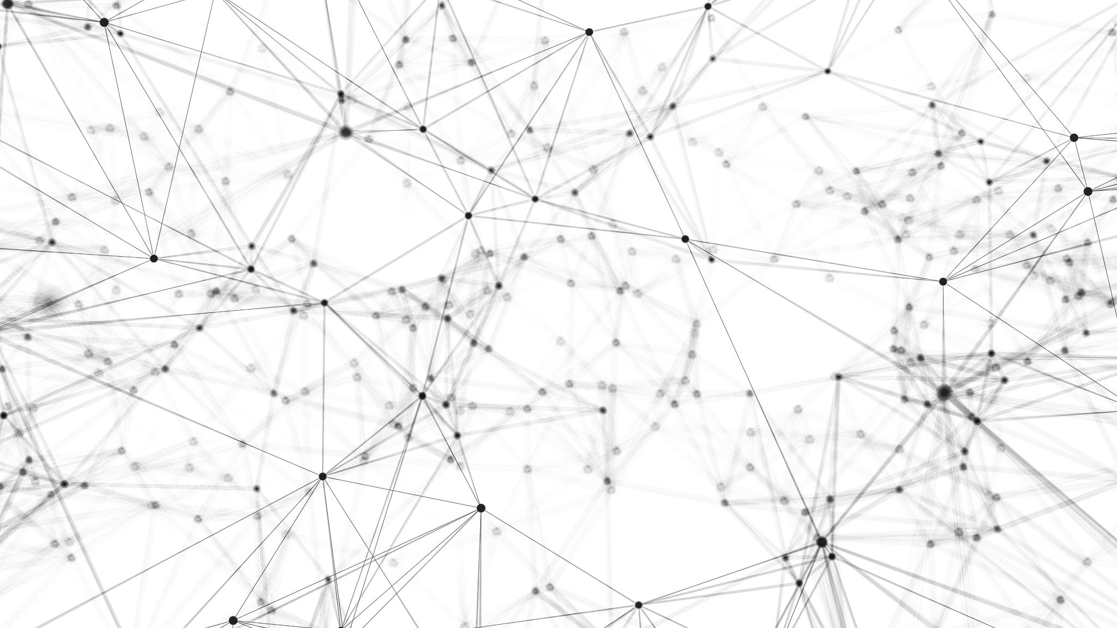
PREDIKSI KUALITAS AIR berdasarkan kelarutan air MENGGUNAKAN METODE DATA MINING
20920006
RIZTY MAULIDA BADRI

Slide 2
PENDAHULUAN
Kualitas air dan tersedia nya air sangat penting bagi kesehatan masyarakat, baik itu digunakan untuk minum, keperluan rumah tangga, produksi makanan atau tujuan rekreasi.
Kualitas air ditentukan oleh faktor fisik-kimiawi dan biologis.
Air yang tercemar dan sanitasi yang buruk terkait dengan penularan penyakit seperti kolera, diare, disentri, hepatitis A, tipus, dan polio.
Layanan air dan sanitasi yang tidak ada, tidak memadai, atau dikelola secara tidak tepat membuat individu terpapar risiko kesehatan yang dapat dicega

Slide 3
TUJUAN
menerapkan pembelajaran mesin untuk membedakan antara air yang dapat diminum dan yang tidak dapat diminum.

Slide 4
TAHAPAN
memasukkan data
membersihkan data
Visualisasi Data
Pre Prosesing Data
Machine Learning Models

Slide 5
MACHINE LEARNING MODEL
Random Forest
Light Gradient Boosted Machine (LightGBM)
Decision Tree Classifier

Slide 6
DATA
Menggunakan Data “water quality” yang di dapatkan dari kagle

Slide 7
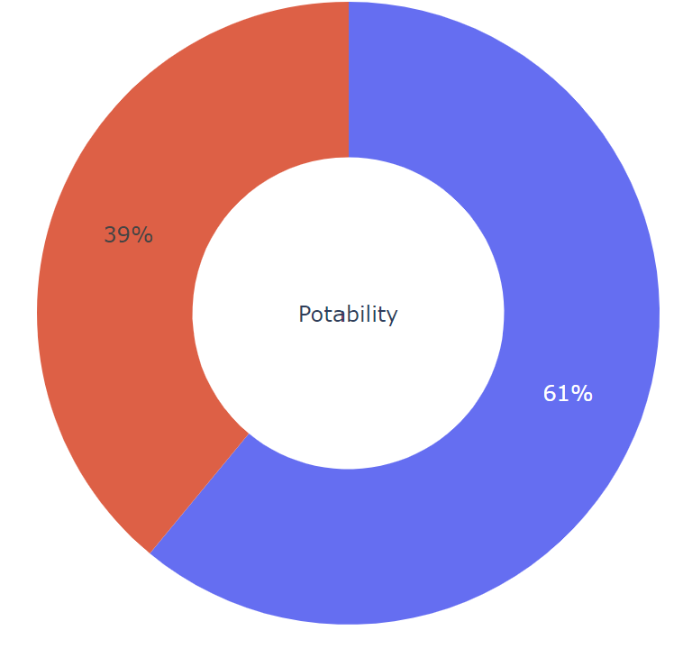
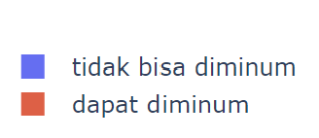
Hasil
d= pd.DataFrame(df['Potability'].value_counts())
fig = px.pie(d,values='Potability',names=['Not Potable','Potable'],hole=0.4,opacity=0.6,
color_discrete_sequence=[colors_green[3],colors_blue[3]],
labels={'label':'Potability','Potability':'No. Of Samples'})
labels = ['tidak bisa diminum','dapat diminum']
fig.add_annotation(text='We can resample the data<br> to get a balanced dataset',
x=1.2,y=0.9,showarrow=False,font_size=12,opacity=0.7,font_family='monospace')
fig.add_annotation(text='Potability',labels = ['tidak bisa diminum','dapat diminum']
x=0.5,y=0.5,showarrow=False,font_size=14,opacity=0.7,font_family='monospace')
fig.update_layout(
font_family='monospace',
title=dict(text='Q. How many samples of water are Potable?',x=0.47,y=0.98,
font=dict(color=colors_dark[2],size=20)),
legend=dict(x=0.37,y=-0.05,orientation='h',traceorder='reversed'),
hoverlabel=dict(bgcolor='white'))
fig.update_traces(textposition='outside', textinfo='percent+label')
fig.show()
Dari Data yang ada, 61 % air tidak dapat diminum dan 39 % dapat diminum

Slide 8
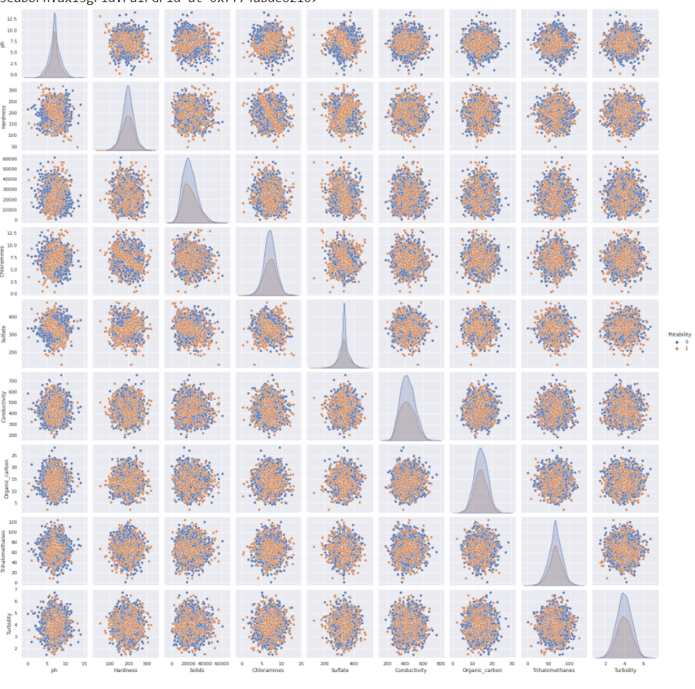
Hasil
hanya ada sedikit korelasi antara features

Slide 9
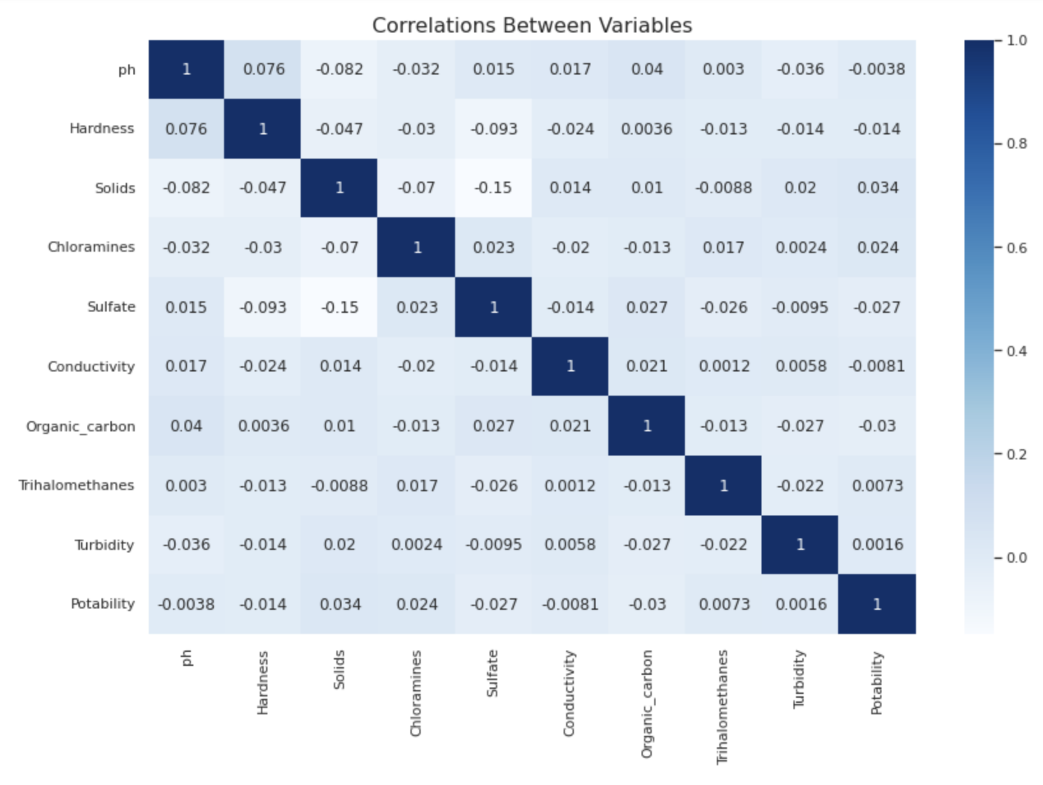
Hasil
d= pd.DataFrame(df['Potability'].value_counts())
fig = px.pie(d,values='Potability',names=['Not Potable','Potable'],hole=0.4,opacity=0.6,
color_discrete_sequence=[colors_green[3],colors_blue[3]],
labels={'label':'Potability','Potability':'No. Of Samples'})
labels = ['tidak bisa diminum','dapat diminum']
fig.add_annotation(text='We can resample the data<br> to get a balanced dataset',
x=1.2,y=0.9,showarrow=False,font_size=12,opacity=0.7,font_family='monospace')
fig.add_annotation(text='Potability',labels = ['tidak bisa diminum','dapat diminum']
x=0.5,y=0.5,showarrow=False,font_size=14,opacity=0.7,font_family='monospace')
fig.update_layout(
font_family='monospace',
title=dict(text='Q. How many samples of water are Potable?',x=0.47,y=0.98,
font=dict(color=colors_dark[2],size=20)),
legend=dict(x=0.37,y=-0.05,orientation='h',traceorder='reversed'),
hoverlabel=dict(bgcolor='white'))
fig.update_traces(textposition='outside', textinfo='percent+label')
fig.show()

Slide 10
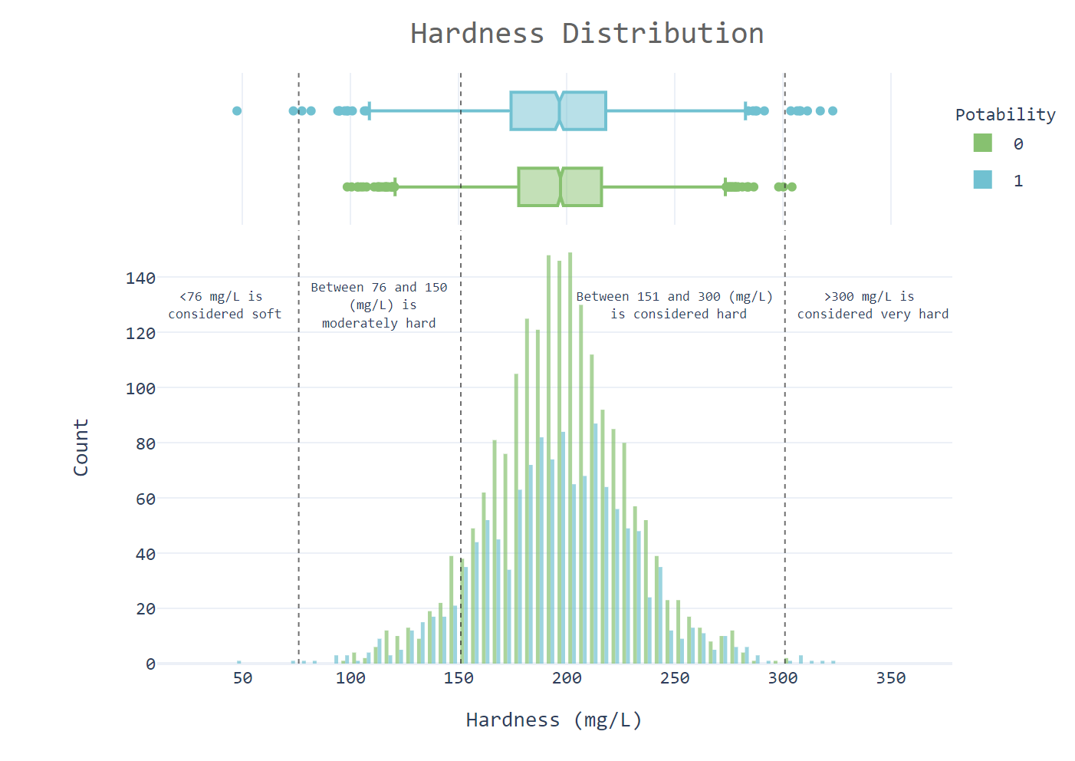
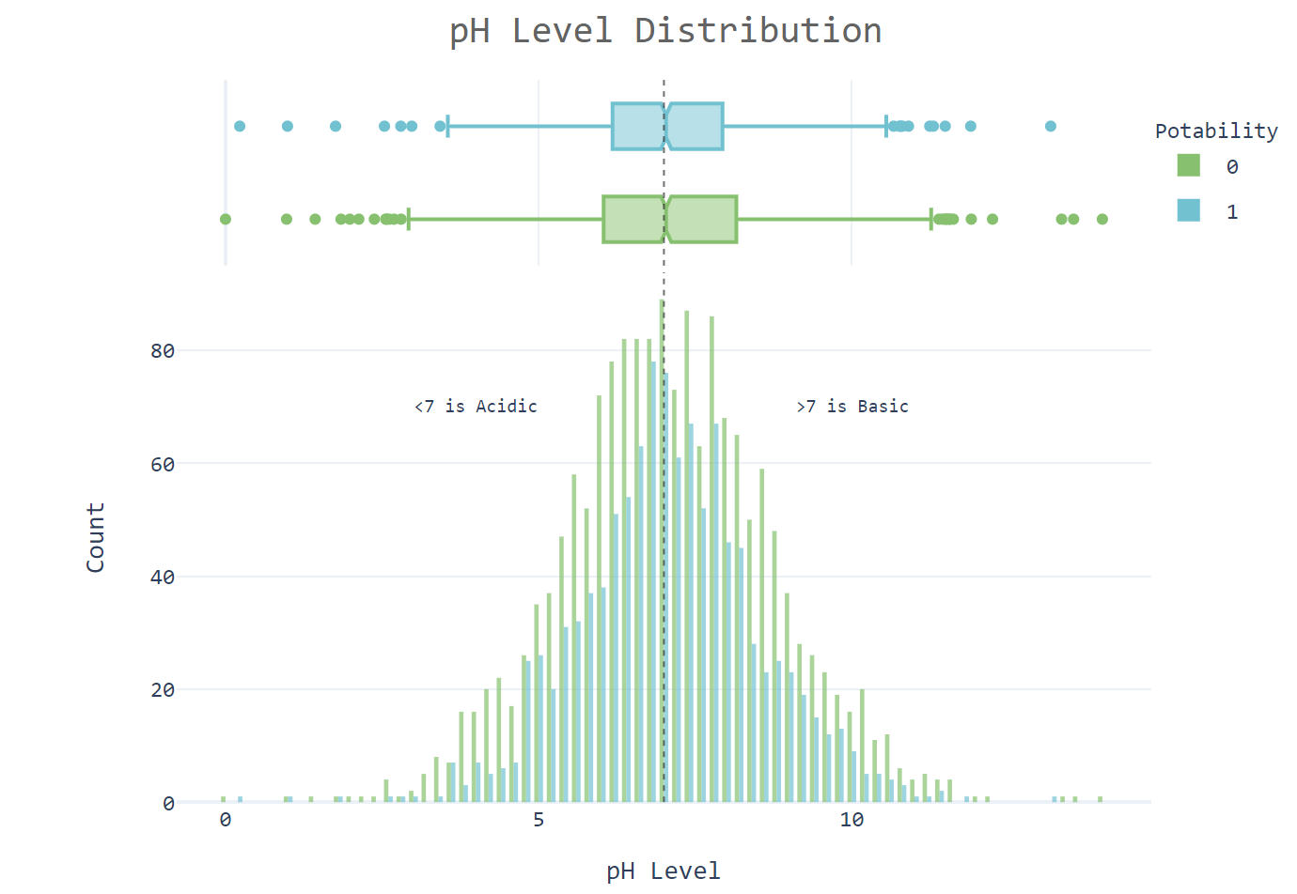
Hasil
d= pd.DataFrame(df['Potability'].value_counts())
fig = px.pie(d,values='Potability',names=['Not Potable','Potable'],hole=0.4,opacity=0.6,
color_discrete_sequence=[colors_green[3],colors_blue[3]],
labels={'label':'Potability','Potability':'No. Of Samples'})
labels = ['tidak bisa diminum','dapat diminum']Hardenss of water: The simple definition of water hardness is the amount of dissolved calcium and magnesium in the water. Hard water is high in dissolved minerals, largely calcium and magnesium. You may have felt the effects of hard water, literally, the last time you washed your hands. Depending on the hardness of your water, after using soap to wash you may have felt like there was a film of residue left on your hands. In hard water, soap reacts with the calcium (which is relatively high in hard water) to form "soap scum". When using hard water, more soap or detergent is needed to get things clean, be it your hands, hair, or your laundry.
fig.add_annotation(text='We can resample the data<br> to get a balanced dataset',
x=1.2,y=0.9,showarrow=False,font_size=12,opacity=0.7,font_family='monospace')
fig.add_annotation(text='Potability',labels = ['tidak bisa diminum','dapat diminum']
x=0.5,y=0.5,showarrow=False,font_size=14,opacity=0.7,font_family='monospace')
fig.update_layout(
font_family='monospace',
title=dict(text='Q. How many samples of water are Potable?',x=0.47,y=0.98,
font=dict(color=colors_dark[2],size=20)),
legend=dict(x=0.37,y=-0.05,orientation='h',traceorder='reversed'),
dilihat dari grafik diatas bahwa :
1. berdasarkan tingkat kesadahan, air yang dapat diiminum lebih dari 90 %
2. berdasarkan level pH, jumlah asam dan basa nya seimbang

Slide 11
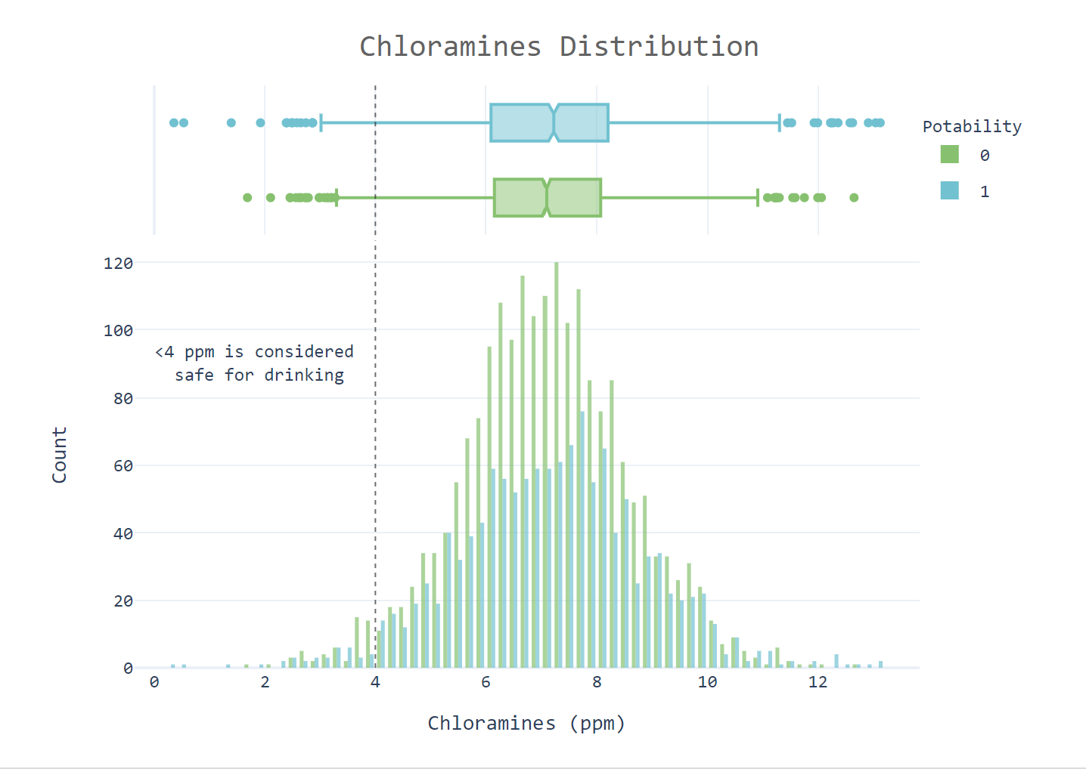
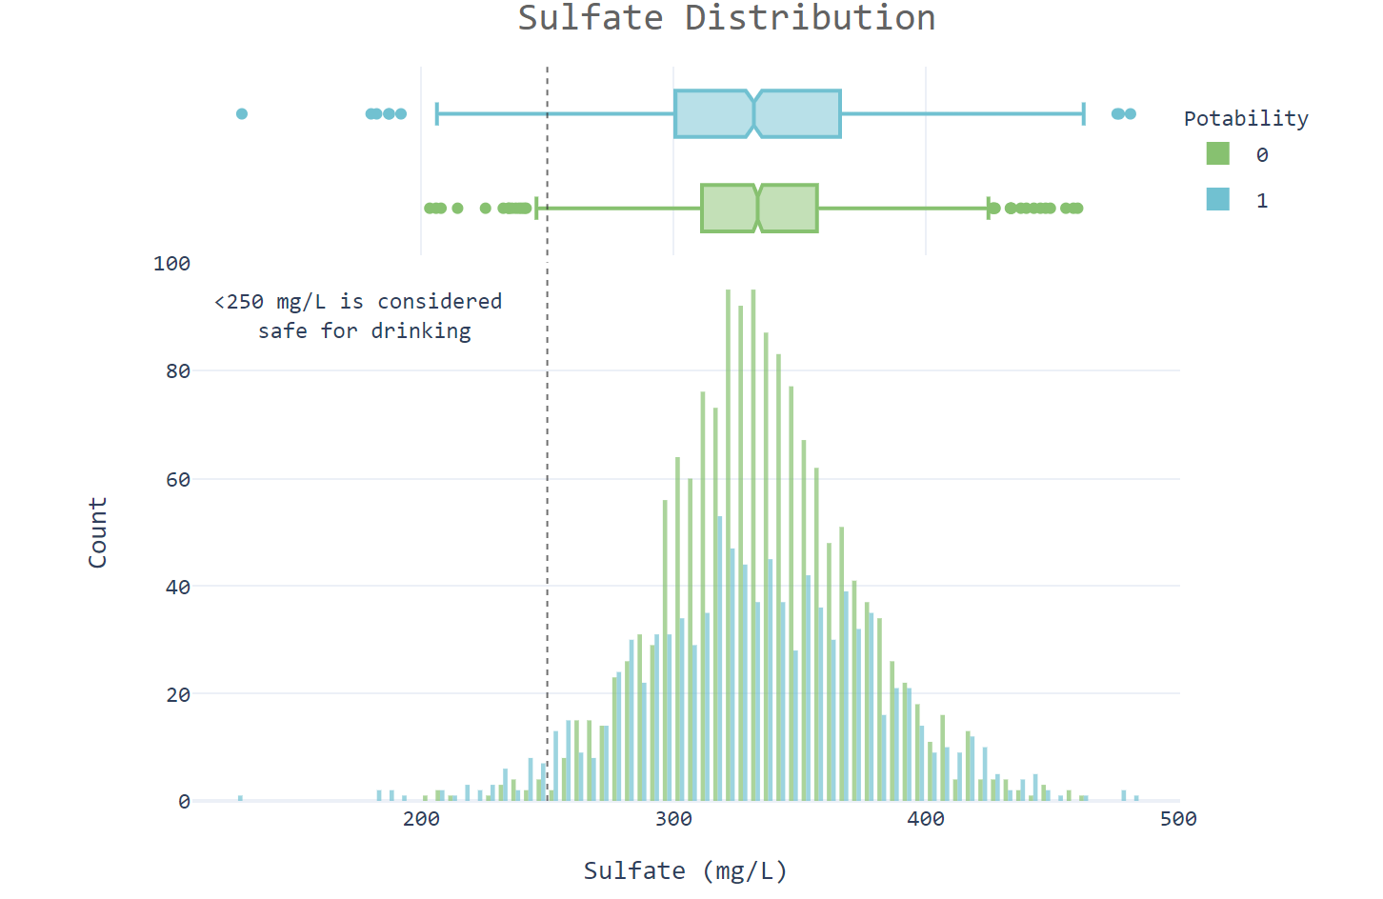
Hasil
d= pd.DataFrame(df['Potability'].value_counts())
fig = px.pie(d,values='Potability',names=['Not Potable','Potable'],hole=0.4,opacity=0.6,
color_discrete_sequence=[colors_green[3],colors_blue[3]],
labels={'label':'Potability','Potability':'No. Of Samples'})
labels = ['tidak bisa diminum','dapat diminum']Hardenss of water: The simple definition of water hardness is the amount of dissolved calcium and magnesium in the water. Hard water is high in dissolved minerals, largely calcium and magnesium. You may have felt the effects of hard water, literally, the last time you washed your hands. Depending on the hardness of your water, after using soap to wash you may have felt like there was a film of residue left on your hands. In hard water, soap reacts with the calcium (which is relatively high in hard water) to form "soap scum". When using hard water, more soap or detergent is needed to get things clean, be it your hands, hair, or your laundry.
fig.add_annotation(text='We can resample the data<br> to get a balanced dataset',
x=1.2,y=0.9,showarrow=False,font_size=12,opacity=0.7,font_family='monospace')
fig.add_annotation(text='Potability',labels = ['tidak bisa diminum','dapat diminum']
x=0.5,y=0.5,showarrow=False,font_size=14,opacity=0.7,font_family='monospace')
fig.update_layout(
font_family='monospace',
title=dict(text='Q. How many samples of water are Potable?',x=0.47,y=0.98,
font=dict(color=colors_dark[2],size=20)),
legend=dict(x=0.37,y=-0.05,orientation='h',traceorder='reversed'),
dilihat dari grafik diatas bahwa :
1. Hanya 2% dari sampel air yang aman dalam hal kadar Kloramin.
2. Hanya 1,8% sampel air yang aman dalam hal kadar Sulfat.

Slide 12
Hasil
d= pd.DataFrame(df['Potability'].value_counts())
fig = px.pie(d,values='Potability',names=['Not Potable','Potable'],hole=0.4,opacity=0.6,
color_discrete_sequence=[colors_green[3],colors_blue[3]],
labels={'label':'Potability','Potability':'No. Of Samples'})
labels = ['tidak bisa diminum','dapat diminum']
fig.add_annotation(text='We can resample the data<br> to get a balanced dataset',
x=1.2,y=0.9,showarrow=False,font_size=12,opacity=0.7,font_family='monospace')
fig.add_annotation(text='Potability',labels = ['tidak bisa diminum','dapat diminum']
x=0.5,y=0.5,showarrow=False,font_size=14,opacity=0.7,font_family='monospace')
fig.update_layout(
font_family='monospace',
title=dict(text='Q. How many samples of water are Potable?',x=0.47,y=0.98,
font=dict(color=colors_dark[2],size=20)),
legend=dict(x=0.37,y=-0.05,orientation='h',traceorder='reversed'),
hoverlabel=dict(bgcolor='white'))
fig.update_traces(textposition='outside', textinfo='percent+label')
fig.show()
Tabel Akurasi dari Machine Learning models yang di uji sebelum di setel
Nomor | Model | Akuraasi
1 | Random Forest | 0,824695
2 | LightGBM | 0,804878
3 | Decision Tree | 0,746951

Slide 13
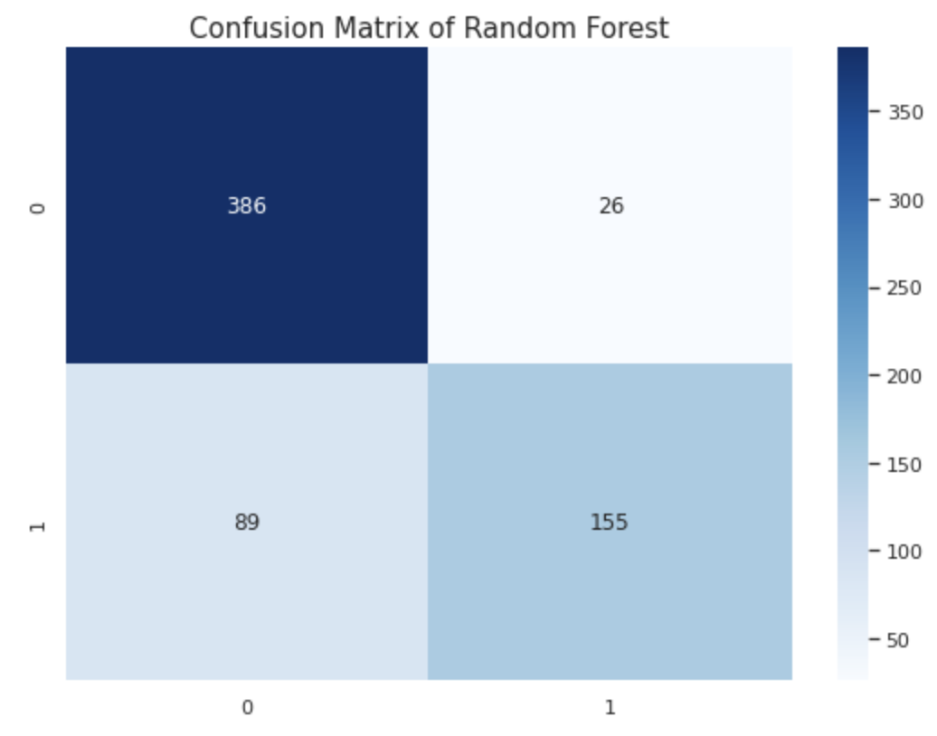
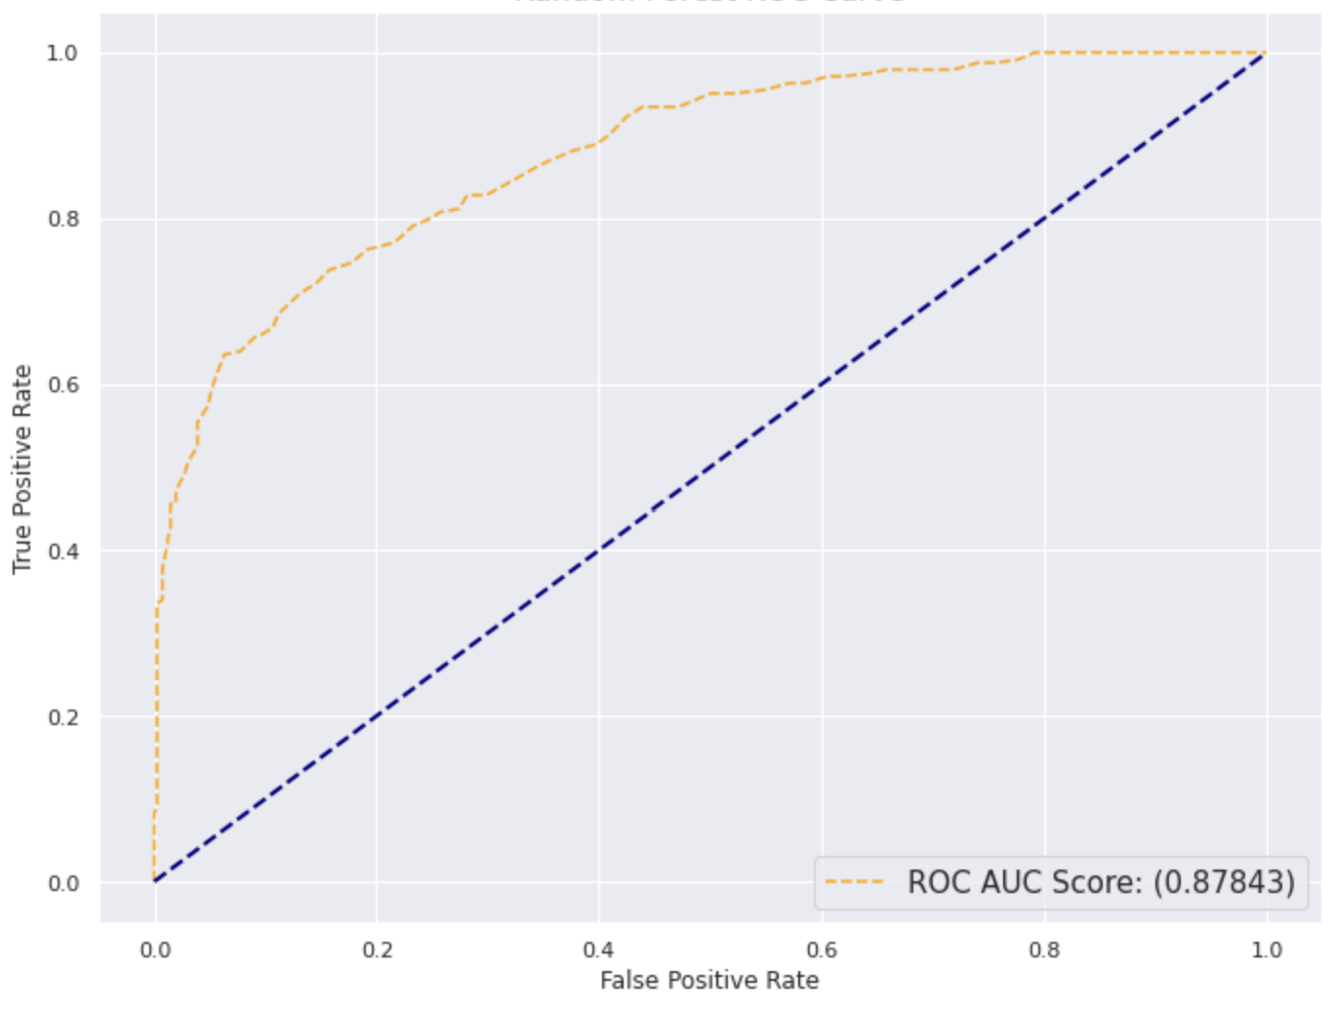
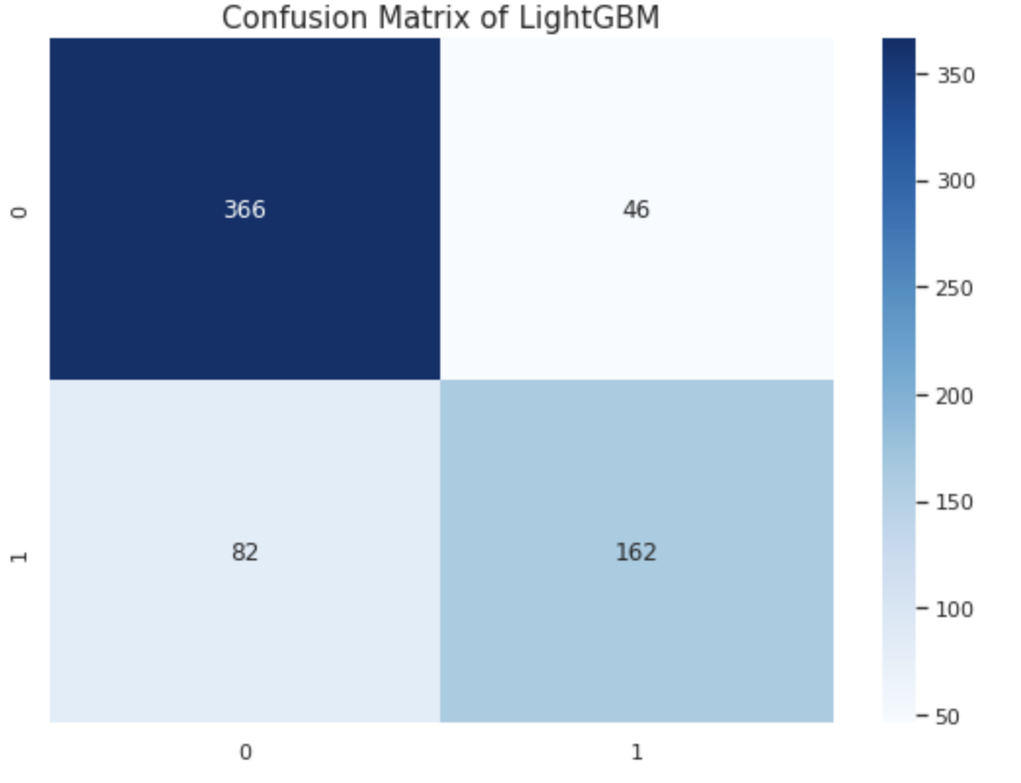
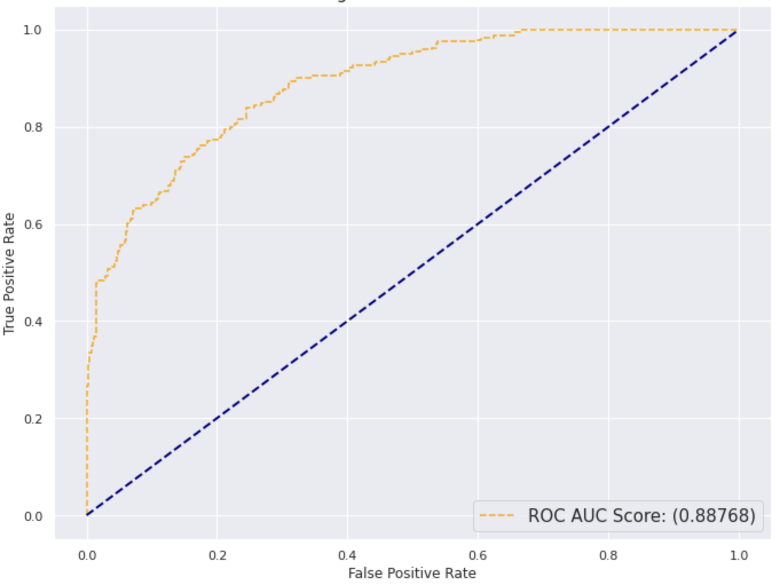
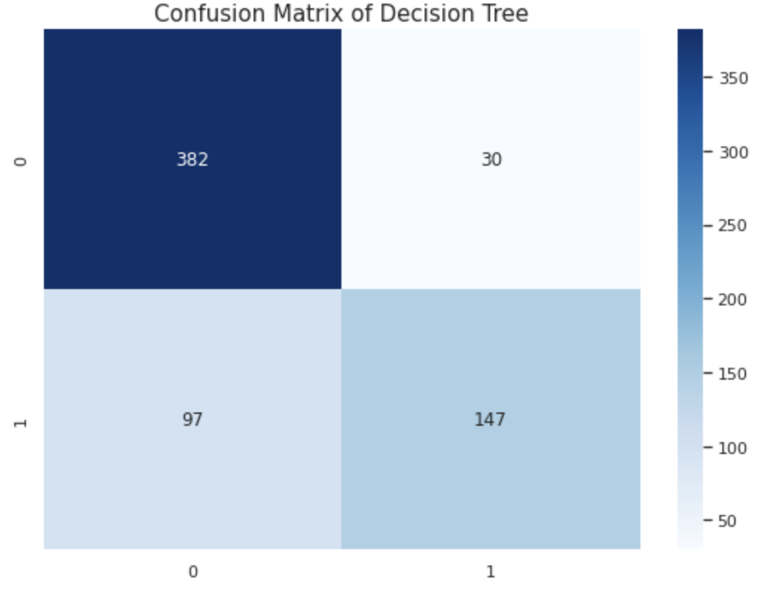
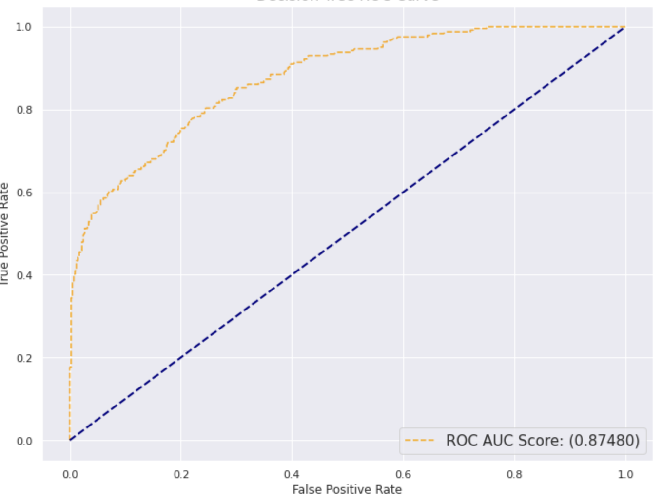
Hasil
d= pd.DataFrame(df['Potability'].value_counts())
fig = px.pie(d,values='Potability',names=['Not Potable','Potable'],hole=0.4,opacity=0.6,
color_discrete_sequence=[colors_green[3],colors_blue[3]],
labels={'label':'Potability','Potability':'No. Of Samples'})
labels = ['tidak bisa diminum','dapat diminum']
fig.add_annotation(text='We can resample the data<br> to get a balanced dataset',
x=1.2,y=0.9,showarrow=False,font_size=12,opacity=0.7,font_family='monospace')
fig.add_annotation(text='Potability',labels = ['tidak bisa diminum','dapat diminum']
x=0.5,y=0.5,showarrow=False,font_size=14,opacity=0.7,font_family='monospace')
fig.update_layout(
font_family='monospace',
title=dict(text='Q. How many samples of water are Potable?',x=0.47,y=0.98,
font=dict(color=colors_dark[2],size=20)),
legend=dict(x=0.37,y=-0.05,orientation='h',traceorder='reversed'),
hoverlabel=dict(bgcolor='white'))
fig.update_traces(textposition='outside', textinfo='percent+label')
fig.show()
No | Model | Confusion matrix | ROC Curve
1 | Random Forest
2 | LightGBM
3 | Decision Tree

Slide 14
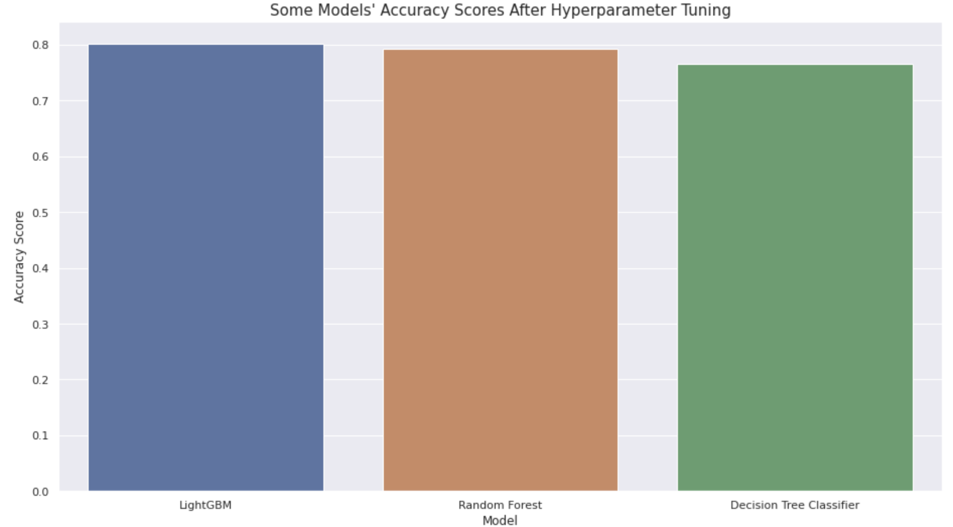
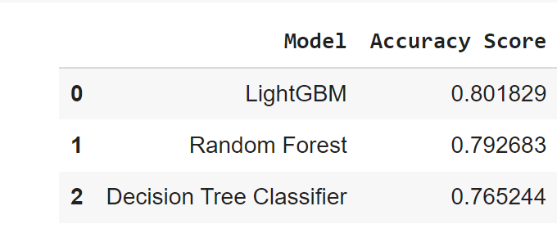
Hasil
d= pd.DataFrame(df['Potability'].value_counts())
fig = px.pie(d,values='Potability',names=['Not Potable','Potable'],hole=0.4,opacity=0.6,
color_discrete_sequence=[colors_green[3],colors_blue[3]],
labels={'label':'Potability','Potability':'No. Of Samples'})
labels = ['tidak bisa diminum','dapat diminum']
fig.add_annotation(text='We can resample the data<br> to get a balanced dataset',
x=1.2,y=0.9,showarrow=False,font_size=12,opacity=0.7,font_family='monospace')
fig.add_annotation(text='Potability',labels = ['tidak bisa diminum','dapat diminum']
x=0.5,y=0.5,showarrow=False,font_size=14,opacity=0.7,font_family='monospace')
fig.update_layout(
font_family='monospace',
title=dict(text='Q. How many samples of water are Potable?',x=0.47,y=0.98,
font=dict(color=colors_dark[2],size=20)),
legend=dict(x=0.37,y=-0.05,orientation='h',traceorder='reversed'),
hoverlabel=dict(bgcolor='white'))
fig.update_traces(textposition='outside', textinfo='percent+label')
fig.show()
Tabel Akurasi dari Machine Learning models yang di uji setelah di setel

Slide 15
KESIMPULAN
1. Tingkat TDS tampaknya mengandung beberapa ketidakjelasan karena nilainya rata-rata 40 kali lipat lebih banyak dari batas atas untuk air minum yang aman
2. Hanya 2% dari sampel air yang aman dalam hal kadar Kloramin.
3. Hanya 1,8% sampel air yang aman dalam hal kadar Sulfat.
4. 90,6% sampel air memiliki kadar Karbon yang lebih tinggi daripada kadar Karbon pada umumnya dalam air minum (10 ppm).
5. 76,6% sampel air aman untuk diminum dalam hal kadar Trihalomethane dalam air.
6. 90,4% sampel air aman untuk diminum dalam hal Kekeruhan sampel air.
7. Koefisien korelasi antar fitur sangat rendah.
8. Dapat diamati bahwa model yang memberikan hasil paling akurat adalah Random Forest Classifier yang tidak disetel dengan skor akurasi 0,824695

